Slide 1


Slide 2

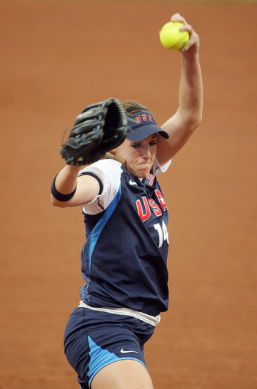

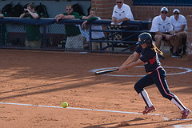
Western Region Training
Softball Differences and Key Points

Slide 3
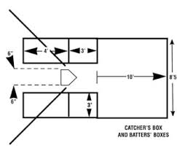
Rules 1.04, 1.07
Softball Playing Field
Batter’s box
  7’ x 3’; four feet forward of break
  and three behind
Catcher’s box
  10’ from back and outside (J/S)
  BLE for 9’ from Point of Plate
  edges of batter’s box (Ma/Mi)
Pitching area
  43’ (J/S)/40’ (Ma)/35’ (Mi)
  8’ circle
  Pitcher’s plate 6” x 24” and level to ground

Slide 4
Rules 1.09/1.10
Softball Ball/Bat
Twelve Inch Optic Yellow Or Other Colors
  Eleven Inch Ball For Minors
Softball Bat
  33” (Ma/Mi)/ 34” (Jr/Sr)length
  2 ¼” Diameter
  Non-Wood Must Have BPF 1.20 Marking
  Non-Wood Must Have a Sleeve Of At Least 10”
  All Bats May Have Tape/Sleeve, Max Of 16”
No Pine Tar or Similar Sticky Material

Slide 5


Rules 1.11-1.15
Uniforms and Gear
Numbered w/same color and style
  Shorts must be uniform
  Hats, visors or nothing
Jewelry prohibited; hair bands in place
Casts are not allowed during the game
  Injured Managers/Coaches/Players may be in the dugout during the game
Catcher may wear any style mitt or glove
First baseman may wear mitt or glove

Slide 6
Rule 1.15
Pitcher’s Uniform Items
Pitcher’s undersleeves shall be a solid color and neoprene sleeves must be single, solid color
Pitching wrist or forearm, Pitchers may not wear sweatbands or bracelets
Non-pitching arm, items must be single, solid color, not distracting, data bands OK
Pitcher cannot wear a Catcher’s or first baseman’s mitt

Slide 7

Rule 2.00
Bunt
Not swung at
Intentionally met
Tapped slowly
To take a pitch in the Strike Zone or not, the bat must be withdrawn backwards…away from the ball

Slide 8


Rules 2.00/8.07
Dropped Ball
While on Pitcher’s plate
  Ball slips from Pitcher’s hand
  Ball goes from the hand straight to the ground during the pitching motion
  No “lift and carry” past the hip
Ball remains live; Runners may advance
Penalty: Ball to the Batter, unless dropped ball crosses foul line

Slide 9
Rule 2.00
Attempted Play
Any feint or bluff at a Runner
  Closes Appeal and Protest of Rule Windows

Slide 10
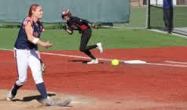
Rule 7.08
Circle Rule
When Pitcher has the ball in the 8’ circle, Runners Shall Immediately Advance from or Return to Their Entitled Base
  Runners Must Maintain Contact With Their Base Until
    The Ball leaves the Pitcher’s hand
    The Pitcher attempts a Play
    The Pitcher drops the Ball
Penalty: Ball is dead, No Pitch, Runner out

Slide 11
Regulation VII
Softball Schedules
Majors may play two doubleheaders/wk
  Three games/day not allowed; Rule 4.12 exception allows a “partial” third game
Jr/Sr may play three games/day
Games should not have time limits, except for lighted field situations
Girls’ teams may not play Boys’ teams

Slide 12
Regulation VI
Pitching Limits
Pitching Limits Set By Division, Not Age
Innings per day |  |  |  | Days rest required for innings pitched
Age | Limit |  |  | Days Rest | Majors/Minors | Junior/Senior
Junior/Senior | None |  |  | None | 6 or less innings/day | None
Majors/Minor | 12 |  |  | 1 day | 7 or more innings/day | None
For Majors/Minors, a Pitcher May Pitch in a Second Game in a Day Up to the 12 Innings/Day Limit
No Innings Per Week Limits

Slide 13
Regulation VI
Twelve YO Exception
Limits for Pitchers in Both Maj/Jr Divisions
  Cumulative Innings pitched in both Divisions
  When the Second Game in the Day is a Majors Game, 12 Innings per day applies
Days Rest Required depends on Division for that Game
  Pitcher in a Juniors Game Is eligible regardless of Innings Pitched in an earlier Majors game on that or a previous day

Slide 14
Regulation VI
Softball Pitching Admin
Pitchers Removed on the Mound
  If remaining in the Game, may return once per Inning
  Jr/Sr, removed from the Mound/Game, return once per Inning if No Violations (MPR, Visits or Substitutions)
  For all Divisions, a Pitcher may be Pinch-Hit/Pinch-Run for and return immediately in the bottom of that Inning
Not more than Five Pitchers in a Game
An Ineligible Pitcher must be Removed
  If Found “Before A Live Ball Is Pitched”, Remove the Ineligible Pitcher; No Protest
  If Discovered after “A Live Ball Is Pitched,” Remove the Ineligible Pitcher; Protest Allowable

Slide 15

Rule 8.01
Key Points Prior to the Pitch
Pivot foot on the rubber; trail foot on or behind the Pitching plate
Both feet must be on the ground to start and remain within the 24-inch length of the Pitcher’s plate

Slide 16

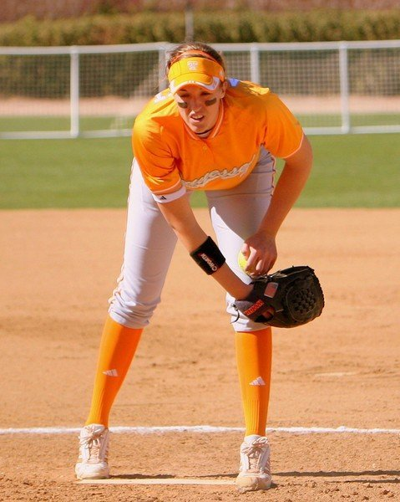
Rule 8.01
Key Points Prior
Shoulders in line with first/third bases
Signs will be taken with hands apart on the pitcher’s plate
Ball shall be held in front of the body in one/both hands for 1-10 seconds before starting delivery
Backward step allowed before or as the hands come together in front of the body

Slide 17
Rule 8.01
Key Points of the Delivery
Windmill or slingshot deliveries approved
Raising/lowering (rocking) the pivot foot during delivery is illegal
While delivering the pitch, one step forward with the non-pivot foot is allowed
The forward stride must remain within the 24” length of the pitcher’s plate

Slide 18
Rule 8.01
Key Points of the Delivery
Pitch Starts when the Hands Separate
  No Motion to Pitch Allowed without Immediately Delivering the Pitch
Underhanded motion
  Hand below the Hip
  Wrist not further from the Body than the Elbow
Second revolution, Hesitation, Behind the back, between the Legs’ Deliveries are Illegal

Slide 19
Rule 8.04
No Pitch
No Pitch declared/Immediate Dead Ball
  A Pitch Delivered during Suspension of Play
  A Runner Is Called Out for Leaving the Base before the Pitch Is Released or Dropped
  Both of the Catcher’s Feet Are Outside the Catcher’s Box when the Pitcher Is Delivered

Slide 20
Rule 8.05
Primary Illegal Pitches
Not in Contact with Pitcher’s Plate
Delivered with Foreign Substance applied
Quick Return Pitch
Leap, Crow Hop or Sidearm
Throw to a Base when in Contact w/Plate
Penalty:
  Ball to the Batter; (Jr/Sr) Runners Advance One Base
  If Batted, Delayed Dead Ball; If B-R and All Runners Advance One Base; Disregard the Infraction and No Manager’s Option; Otherwise, Manager’s Option to Accept the Play or the Penalty

Slide 21
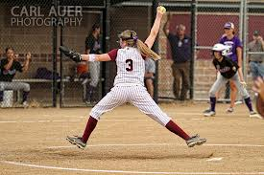
Rule 2.00
Leap
It is a “Leap” if both feet leave the ground on the initial move and push from the Pitcher’s Plate…the Pivot Foot does not drag away from the Pitcher’s Plate

Slide 22
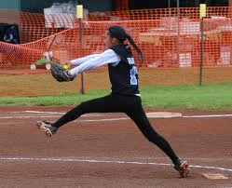
Rule 2.00
Crow Hop
It is a “Crow Hop” if the Pivot Foot leaves the Pitcher’s Plate, re-plants, and pushes off from a second, more forward position

Slide 23
Rule 2.00
Sidearm Motion
It is a “Sidearm Delivery” when the wrist is further from the body than the elbow as the arm passes the hip on delivery

Slide 24
Rule 8.00
Pitching Bottom Line
The Pivot Foot must push off and drag away from the Pitching Plate
It is a “Leap” when the Pivot Foot leaves the ground before the Trail Foot Touches the ground on the Initial Move
It is a “Crow Hop” when the Pivot Foot leaves the Rubber, er-plants, and pushes off from a second, more forward spot

Slide 25


