Slide 1


Slide 2
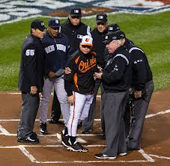
Line Up Card Overview

Slide 3
Why a Lineup Card?
Rule 4.01 requires the Umpire-in-Chief to receive the batting order in duplicate from each team before the start of the game
After verifying the duplicate copy of the batting order is the same, the UIC passes the second copy to the other team Manager
The Plate Umpire retains the original copy of the lineup to be followed for the remainder of the game until substitutions are made

Slide 4
Lineup Card Contents
The Plate Umpire’s lineup card is a summary of the game, tracking key items required by Rules/Regulations
  Batting Order (Name, #) - Offensive Visits
  Initial Substitutions - Defensive Visits
  Re-entry Substitutions - Special Pinch Runners
  Special Situations (P->C; C->P)
As long as the Plate Umpire can re-construct the game, there is no requirement that any specific scheme is required by Rule
Here are two of hundreds of possible lineup cards…they should be used like a suit of clothes…if it fits, use it

Slide 5
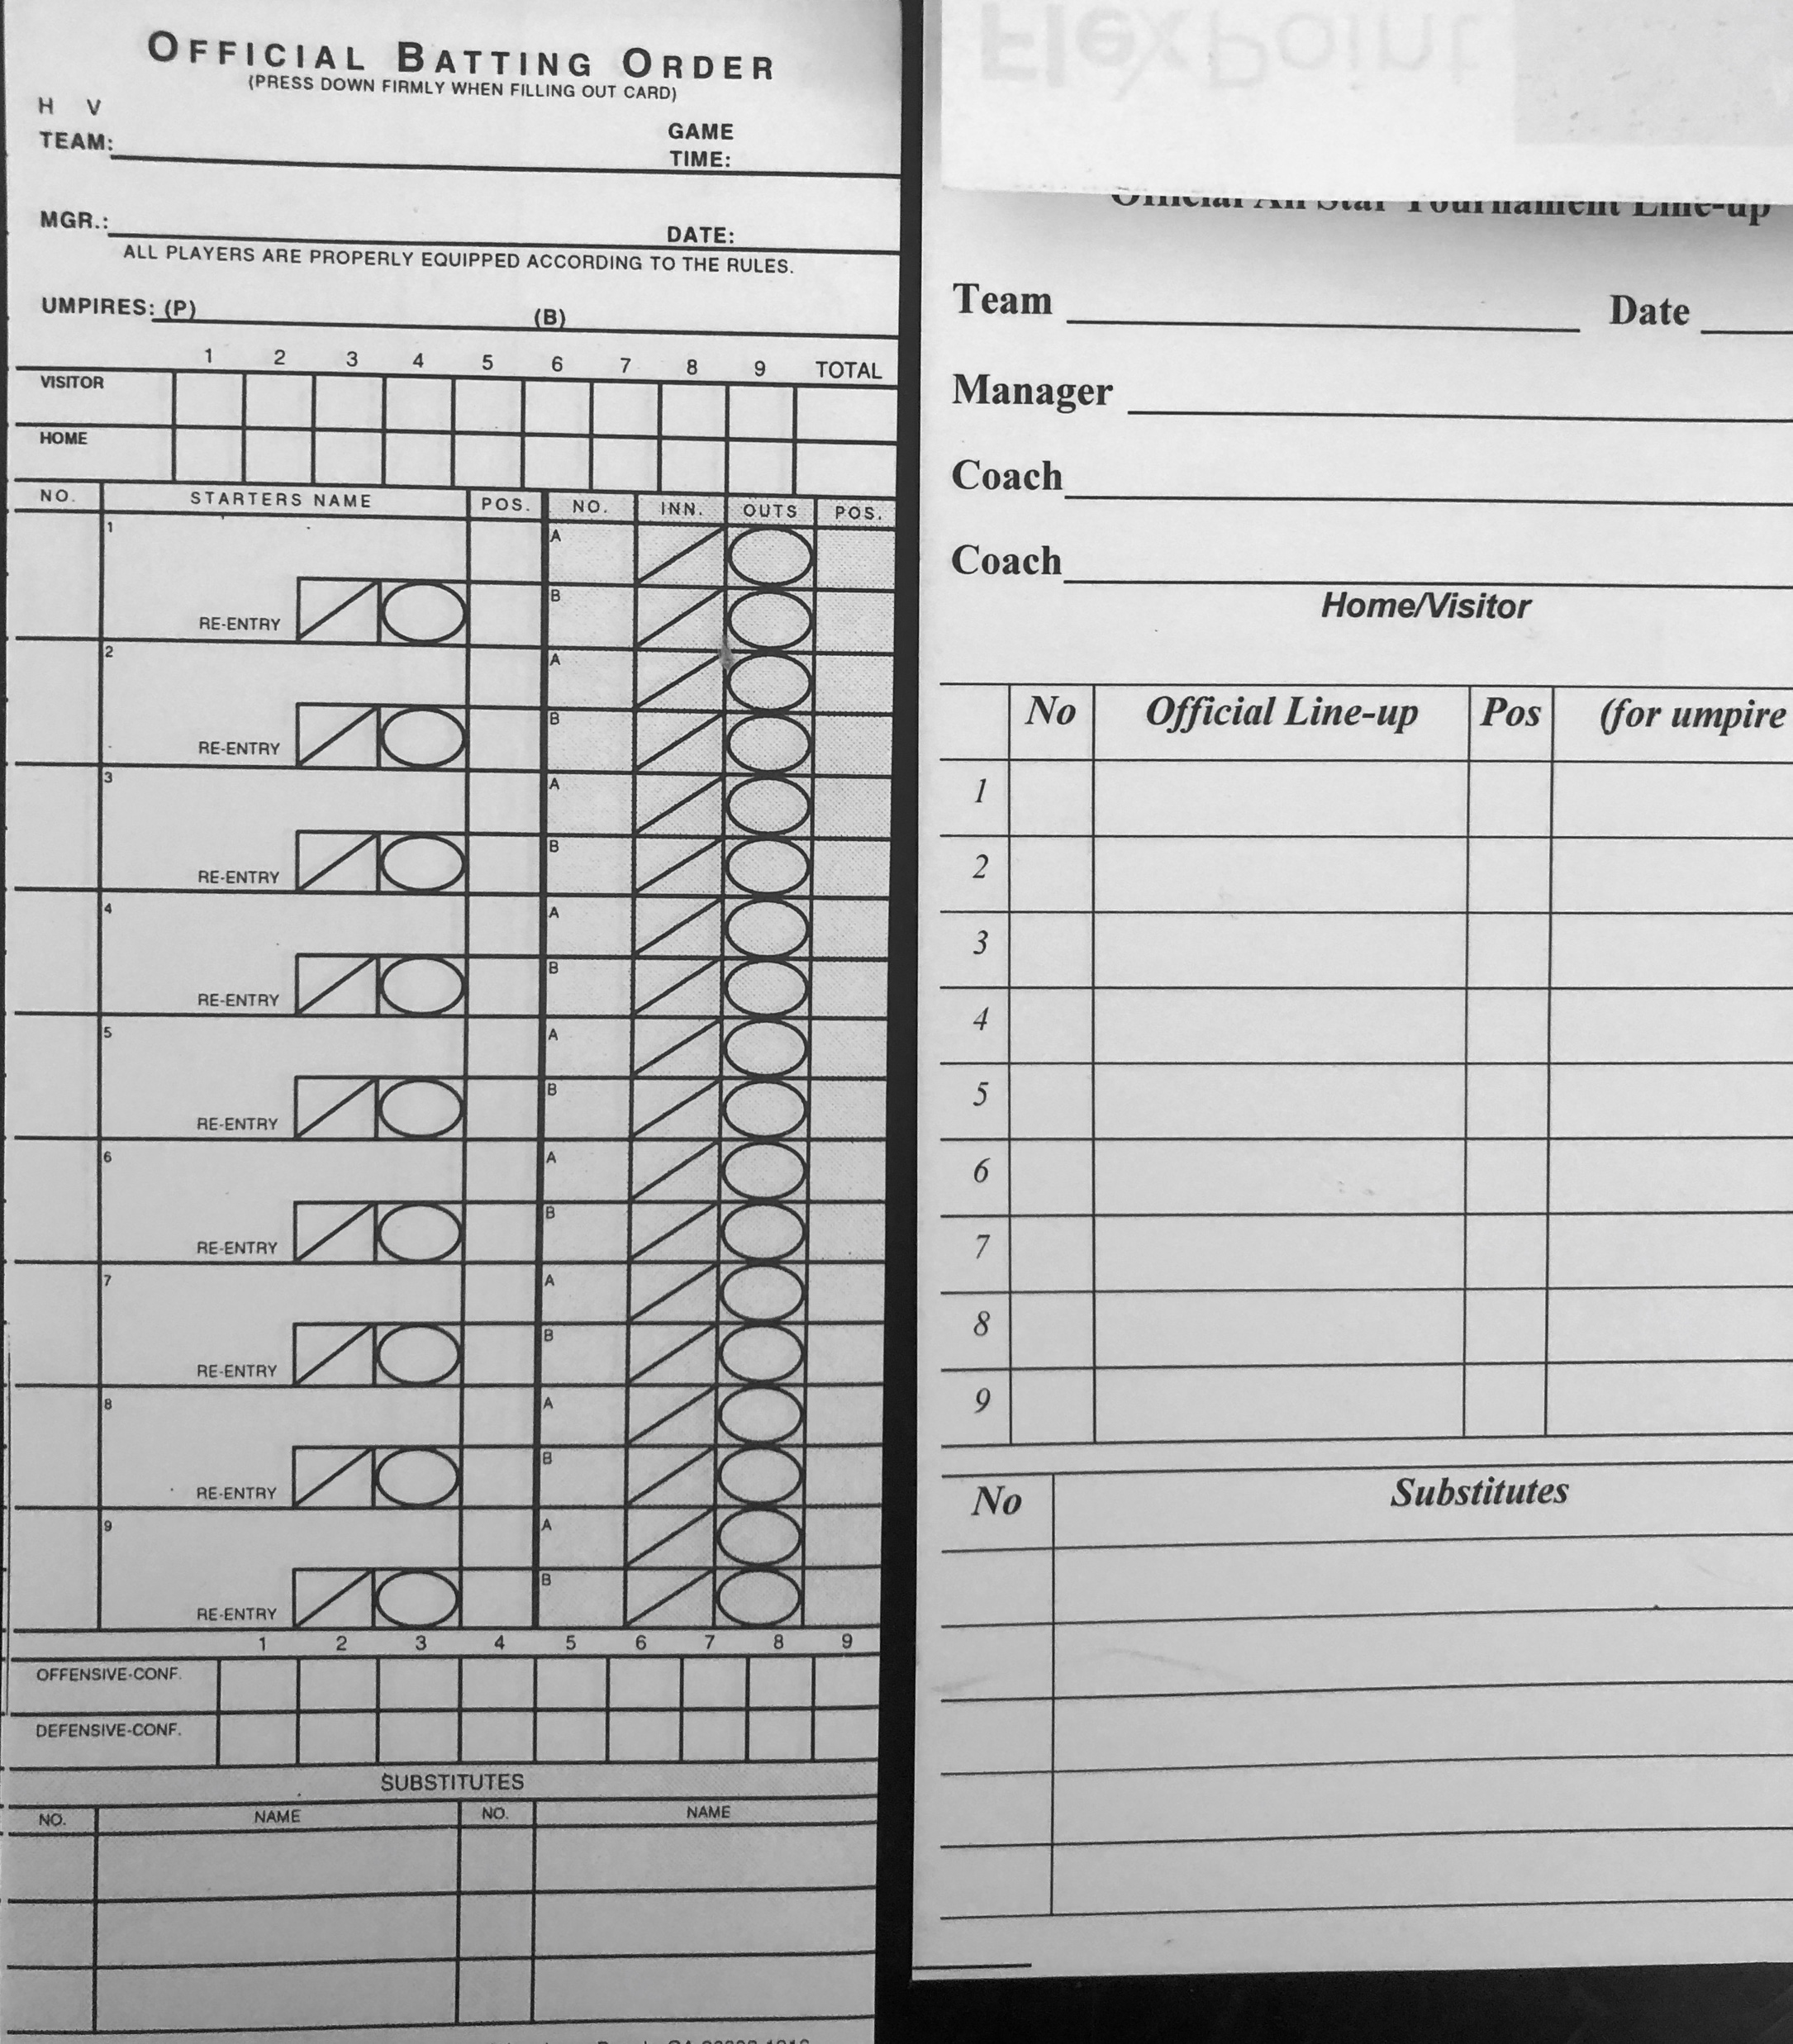
Lineup Card Varieties
Order
Subs
MPR
Pitching
Catching
SPR
Each scheme is unique and meets different approaches

Slide 6
Lineup Card Illustration
 | H XXXX |  |  | V
 | Team: |  | Roadrunners
 | Manager: |  | Romeo Adonis
 | Coaches: |  | Mercutio Capulet; Iago Umplover
 | Date: |  | July 27, 2020
 | Time: |  | 1500
 | #/SPR | Name |  |  |  |  |  | Pos | Substitutions/Re-entries
 | 11 | Mike Snidely |  |  |  |  |  | 8
 | 3 | Billy Baseknock |  |  |  |  |  | 4
 | 9 | Roberta Noway |  |  |  |  |  | 2
 | 16 | Tom Justcause |  |  |  |  |  | 3
 | 2 | Timmy Notlikely |  |  |  |  |  | 1
 | 6 | Ralph Comeon |  |  |  |  |  | 7
 | 10 | George Somehow |  |  |  |  |  | 9
 | 14 | Sally Ontask |  |  |  |  |  | 6
 | 5 | Oleg Runamok |  |  |  |  |  | 5
 | Pitcher # | 1 | 2 | 3 | 4 | 5 | 6 | 7 | Inelig Pitch | 14, 16
 | Visits | 1 | 2 | 3 | 4 | 5 | 6 | 7 | Notes
 | Catcher # | 1 | 2 | 3 | 4 | 5 | 6 | 7
 | Subs | 1 | Name | Toby Blutarsky
 |  | 4 | Name | Johnny Amazing |  |  |  | 12 | Name | Amanda Tripleplay
 |  | 7 | Name | Sean Sunrise |  |  |  | 8 | Name | Phil Wildthing

Slide 7
Assessing the Lineup Card Header
H XXXX |  |  | V
Team: |  | Roadrunners
Manager: |  | Romeo Adonis
Coaches: |  | Mercutio Capulet; Iago Umplover
Date: |  | July 27, 2020
Time: |  | 1500
Verify the Header material to be adequate
Home or Visitor circled or somehow indicated
Team Name
Manager’s Name…first name, if that is your style
Coaches’ Name(s)…good info for the Base Umpires
Date of the Game…helps keep track in multi-game tournaments
Time of the Game

Slide 8
Assessing the Lineup Card Starters
#/SPR | Name | Pos
11 | Mike Snidely | 8
3 | Billy Baseknock | 4
9 | Roberta Noway | 2
16 | Tom Justcause | 3
2 | Timmy Notlikely | 1
6 | Ralph Comeon | 7
10 | George Somehow | 9
14 | Sally Ontask | 6
5 | Oleg Runamok | 5
Verify nine Players are listed along with their uniform numbers and position number
Verify there are no duplicate uniform numbers and each Player is assigned a unique position
  In the event of Pool Players with same numbers, ensure some distinguishing feature is listed
Each Player should be listed by AT LEAST last name with first name or initial for siblings or similar last names

Slide 9
Noting the Additional Info
Player Non-starting Substitutes are listed by Name and Uniform Number similar to Starters
Section covering Pitcher’s and Catcher’s pitches/innings and Visits allow the Plate Umpire to track limits on Pitcher/Catcher movement
Ineligible Pitcher section guards against illegal substitution
Notes section allows for concise notetaking
Pitcher # | 1 | 2 | 3 | 4 | 5 | 6 | 7 | Inelig Pitch | 14, 16
Visits | 1 | 2 | 3 | 4 | 5 | 6 | 7 | Notes
Catcher # | 1 | 2 | 3 | 4 | 5 | 6 | 7
Subs | 1 | Name | Toby Blutarsky
 | 4 | Name | Johnny Amazing |  |  |  | 12 | Name | Amanda Tripleplay
 | 7 | Name | Sean Sunrise |  |  |  | 8 | Name | Phil Wildthing

Slide 10
Noting the Substitute Section
Each box indicates a substitution in the batting position
Top-left of box is the Substitute’s Uniform Number; Bottom-right of the box is for the inning entered
If the substitution is a defensive Substitute made with other than No Outs, indicate by a “-1” or “-2”
Use a similar entry if a second or third non-Starting Substitute is used
Re-entry is done similarly by entering the Uniform Number and Inning entered
NOTE: ALL Re-entries must be done on the same batting line
Substitutions/Re-entries

Slide 11
One Way of Doing It

Slide 12
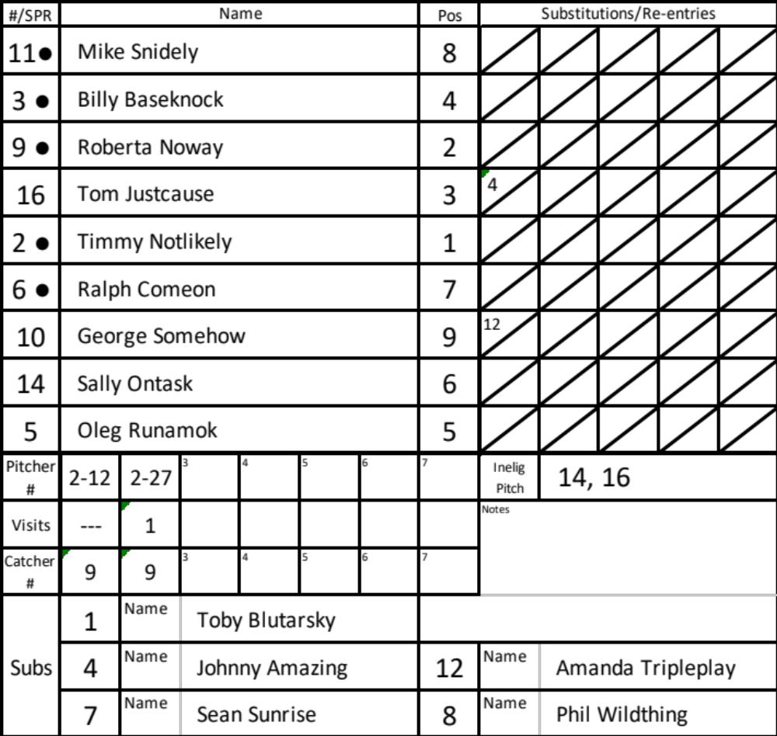
Lineup Card; End of 2
The Roadrunners had three batters in the each of the 1st and 2nd innings (AB’s noted by “dot •”)
#4 entered defensively with one out in the top of the 2nd
#12 went to right field at the start of the 2nd
#2 threw 12 pitches in the 1st and 15 more in the 2nd inning
The Roadrunner Manager visited with the second baseman in the 2nd inning
#9 played the position of Catcher for the first two innings
∙
2-1
2

Slide 13
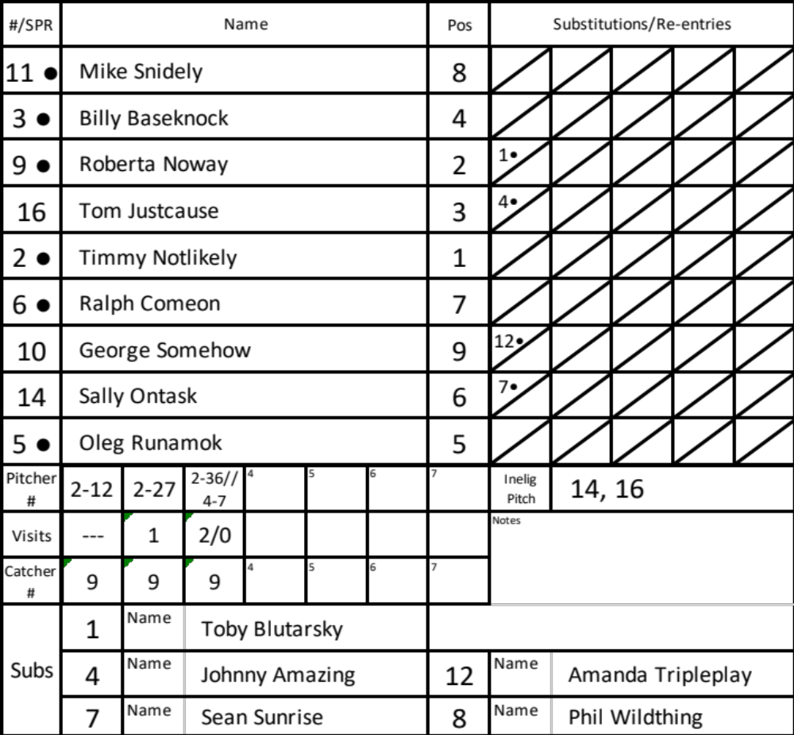
Lineup Card; End of 3
The Roadrunners had six batters (slots 7->3) bat in the bottom of the 3rd (AB’s noted by “dot •”)
In the third batting slot, #1 batted for #9 in the the 3rd
In the 8th batting slot, #7 batted for #14 in the 3rd
#2 threw 7 pitches in the 3rd before being visited and threw 2 more before being replaced by #4. #4 threw seven more pitches
#9 played the position of Catcher in the 3rd inning
3
2-1
2
2
3
3

Slide 14
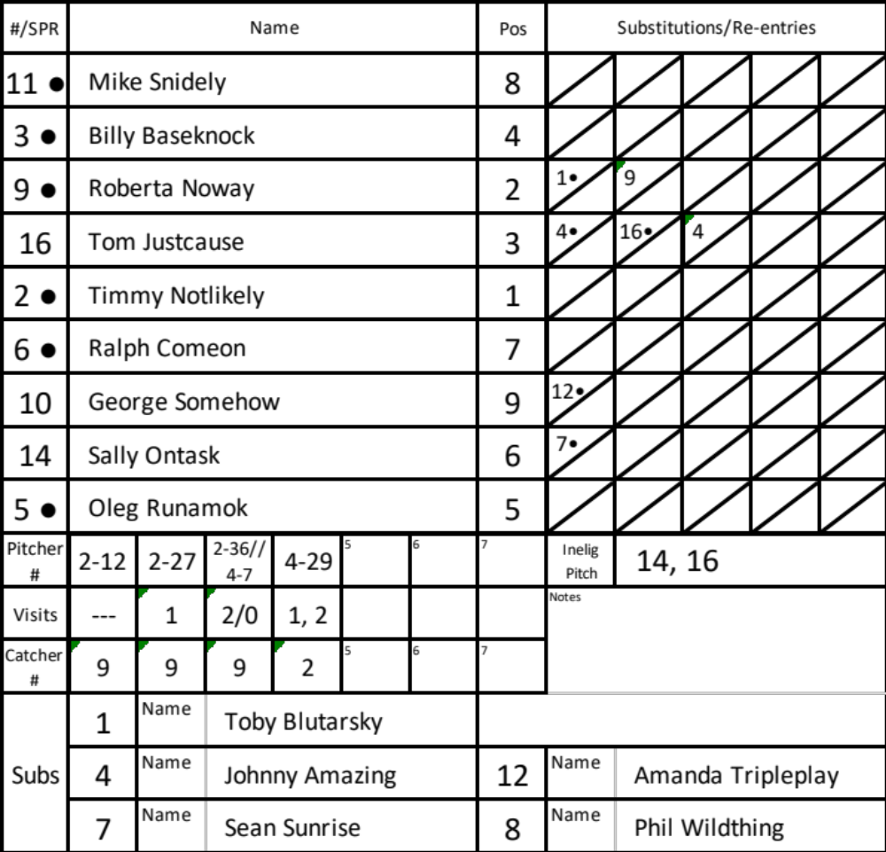
Lineup Card; End of 4
The Roadrunners had three batters (slots 4-6) bat in the the 4th ; (AB’s noted by “dot •”)
In the third batting slot, #9 re-entered for #1 in the 4th
In the fourth batting slot, #16 re-entered to bat for #4 in the 4th and singled
In the fourth batting slot, #4 re-entered to run for #16 in the 4th (SPR?)
#4 threw 22 pitches in the 4th and was visited twice
#2 played the position of Catcher in the 4th inning
3
4
2-1
4
4
2
2
3
3

Slide 15
What Is in Store in the 5th?
Things to Consider approaching the end of the Game:
Elements relating to Mandatory Play
That All Players have achieved One AT Bat and Six Defensive Outs (Consecutive for Non-Starting Substitutes)
4th, 5th, and 6th inning Substitutions must guarantee an At Bat and sufficient consecutive defensive outs in all “three up, three down” situations
Pitcher to Catcher and Catcher to Pitcher limits
  No more than 40 pitches, before Catching
  No more than 3 innings as a Catcher, before Pitching

Slide 16
Lineup Card; Looking to the 5th
Yet to bat?
#10 and #14
Yet to play at all?
#8
Can #9 pitch?
Yes, 3 or less innings as Catcher
How many Day’s Rest for #2?
Two days, started last batter before 35 pitches
3
4
2-1
4
4
2
3

Slide 17


